Slide 1
Project Scheduling

Slide 2
Why care about project management?
10% of projects successful between 1998 and 2004

Slide 3
Software project scheduling is an action that distributes estimated effort across theplanned project duration by allocating the effort to specific software engineering
tasks.

Slide 4
Basic Principles
Compartmentalization
A milestone is accomplished when one or more work products
has been reviewed for quality (Chapter 15) and has been approved.
Interdependency.
Time allocation
Effort validation
Defined responsibilities
Defined outcomes
Defined milestones

Slide 5
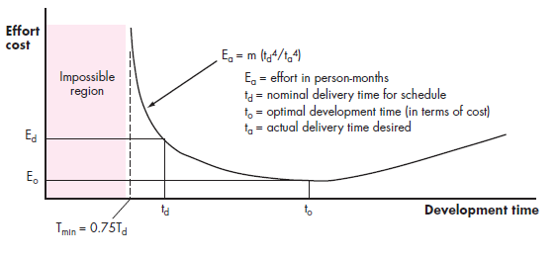
The Relationship Between People and Effort
The relationship
between
effort and
delivery time

Slide 6
most software organizations encounter the following projects:
DEFINING A TASK SET FOR THE SOFTWARE PROJECT
Concept development projects that are initiated to explore some new business concept or application of some new technology.
New application development projects that are undertaken as a consequenceof a specific customer request.
Application enhancement projects that occur when existing software undergoes major modifications to function, performance, or interfaces that are observable by the end user.
Application maintenance projects that correct, adapt, or extend existing softwarein ways that may not be immediately obvious to the end user.
Reengineering projects that are undertaken withthe in tent of rebuilding an existing (legacy) system in whole or in part.

Slide 7
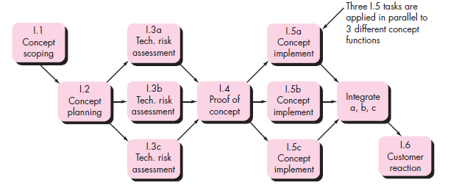
Activity network
A task network, also called an activity network, is a graphic representation of the task flow for a project. It is sometimes used as the mechanism through which task sequence and dependencies are input to an automated project scheduling tool.

Slide 8
SCHEDULING
Program evaluation and review technique (PERT) and the critical path method (CPM)are project scheduling methods that can be applied to software development.
Both techniques are driven by information already developed in earlier project planning activities: estimates of effort, a decomposition of the product function, the selection of the appropriate process model and task set, and decomposition of the tasks that are
selected.

Slide 9
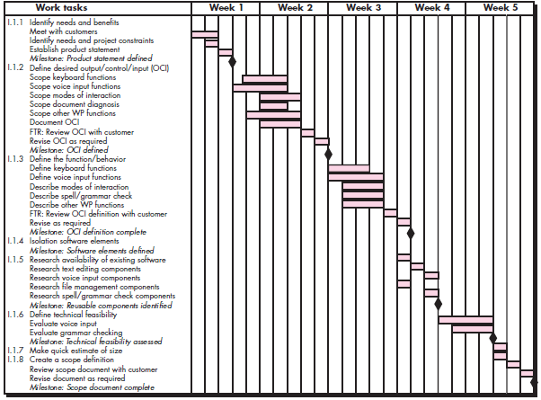
Time-Line Charts/ Gantt chart

Slide 10
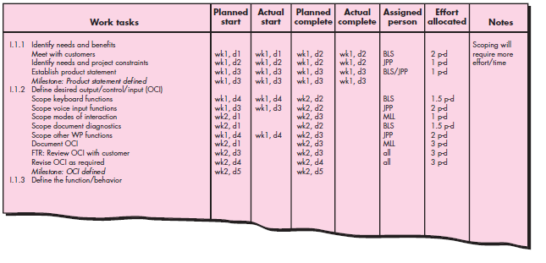

Slide 11
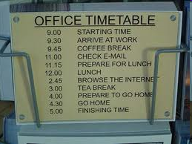
Scheduling
One of the most
important things you
can do is schedule.
Also one of the first things you should do!
Tools help
Microsoft Project
OpenProj.org
OpenWorkbench.org
Notes:
Starting here on April 1, 2010

Slide 12
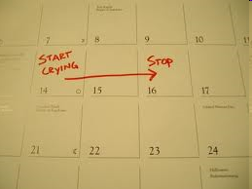
Planning
The bad news: time flies
The good news: you’re the pilot!
You must begin planning
immediately
Given limited information
Plan anyway and then
revise

Slide 13
Creating a plan: Things to know
Scope
Context. How does the software to be built fit into a larger system, product, or business context and what constraints are imposed as a result of the context?
Information objectives. What customer-visible data objects (Chapter 8) are produced as output from the software? What data objects are required for input?
Function and performance. What function does the software perform to transform input data into output? Are any special performance characteristics to be addressed?
Software project scope must be unambiguous and understandable at the management and technical levels.

Slide 14
Creating a plan: Things to do
Problem Decomposition: Sometimes called partitioning or problem elaboration
Once scope is defined …
It is decomposed into constituent functions
It is decomposed into user-visible data objects
or
It is decomposed into a set of problem classes
Decomposition process continues until all functions or problem classes have been defined (this won’t be far at the beginning of your project)

Slide 15
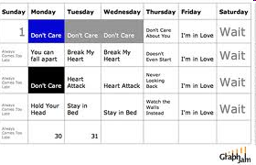
Schedule
List of tasks
With dates
With assigned resources (people)
With durations
With predecessors and successors
How do you get buy-in from the team for a schedule?
History
Increments
Notes:
Use historical data from past projects
Use an incremental model that will deliver critical pieces of info

Slide 16
Schedule Terms
Critical path
Sequence of tasks that form the longest path to completion of the project. Any delay on any of these will make the overall completion date move.
Slack
Amount of time a task can be delayed without affecting the overall completion date.
Start slack - amount before task needs to start
Finish slack - amount before task needs to finish
Milestone - An import date in the schedule
Dependencies - relationship between tasks

Slide 17
Schedule Dependencies
FS - Finish to start (most common)
A FS B. B doesn’t start until A is finished
Build wall FS Paint wall
FF - Finish to finish
A FF B. B doesn’t finish before A is finished
Write final chapter FF Complete Index
SS - Start to start
A SS B. B doesn’t start until A has started
Project funded SS project management activities begin
SF - Start to finish
A SF B. B doesn’t finish before A has started
Once A starts, B is allowed to finish
B=Baby sit a child, A=parent comes home
Notes:
For the SF dependency think of the task that triggers the other task. For example, study for exam SF write exam. When you start writing the exam, that is the trigger to stop studying for the exam. Not often used.

Slide 18
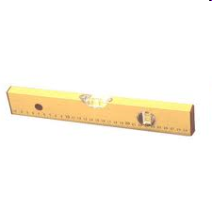
Resource Leveling
A process to examine a project for an unbalanced use of people and to resolve over-allocations or conflicts
Happens when multiple tasks are scheduled at the same time for the same person
Solution:
Make tasks sequential by introducing “fake” dependencies
Split resource usage among tasks (50% on task 1, 50% on task 2)

Slide 19
Auto Resource Leveling
Some tools (not Open Project) provide auto resource leveling
Tool automatically ensures no person works over 100% of the time (automatically makes tasks sequential)
Advantageous because this does not introduce “fake” dependencies

Slide 20
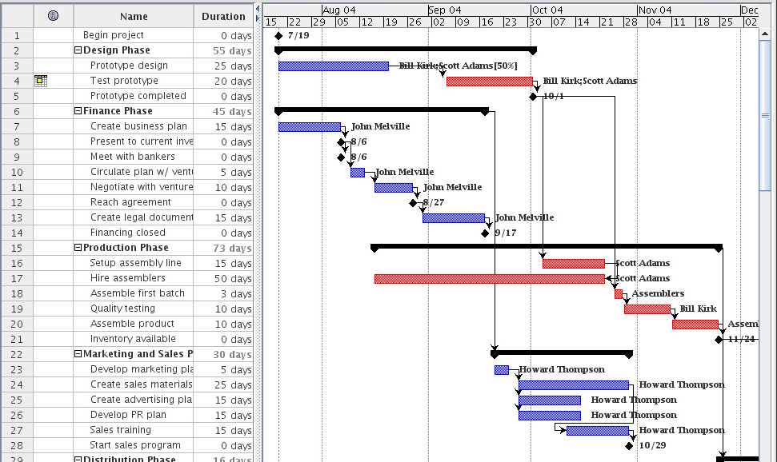
Gantt Chart
Notes:
Got here late class Apr, 1, 2010

Slide 21
Finding Critical Path
Draw a network diagram of the activities
Determine the Early Start (ES) of each node. Work from beginning node (ES=0) to final node
ES - earliest time the activity can start
ES = Max(ESprevNode + DurationPrevNode)
ES: 4
A
7
ES: ??
10
C
ES: 2
B

Slide 22
Finding Critical Path
Determine the Late Start (LS) of each node. Work from the final node to the beginning node.
The latest time the activity can start without changing the end date of the project
LS = MIN(LSnext - DurationNode)
For the last node LS = ES
LS: 13
B
10
LS: ?
LS: ?
A
7
LS: 12
A
LS: 12
7
10
C
C
LS: ?
B

Slide 23
Example
Here's the example:
Activity Description Predecessor Duration
A Product design (None) 5 months
B Market research (None) 1
C Production analysis A 2
D Product model A 3
E Sales brochure A 2
F Cost analysis C 3
G Product testing D 4
H Sales training B, E 2
I Pricing H 1
J Project report F, G, I 1

Slide 24
Example Node Network
ES(H)
ES(E)+dur(E) = 5 + 2 = 7
ES(B)+dur(B) = 0 + 1 = 1
Maximum = 7 = ES(H)
ES:5 LS:
ES:7 LS:
ES(J)
ES(F)+dur(F) = ?
ES(G)+dur(G) = ?
ES(I) + dur(I) = ?
Maximum = ? = ES(J)
C
F
ES:0 LS:
ES:12 LS:
A
ES:5 LS:
D
G
J
ES:8 LS:
ES:0 LS:
ES:5 LS:
B
E
I
ES:9 LS:
H
Here's the example:
Activity Description Predecessor Duration
A Product design (None) 5 months
B Market research(None) 1
C Production A 2
D Product model A 3
E Sales brochure A 2
F Cost analysis C 3
G Product testing D 4
H Sales training B, E 2
I Pricing H 1
J Project report F, G, I 1
ES:7 LS:

Slide 25
Example Node Network
LS(A) =
LS(C) – dur(A) = 7 – 5 = 2
LS(D) – dur(A) = 5 – 5 = 0
LS(E) – dur (A) = 7 – 5 = 2
Minimum = 0 = LS(A)
ES:5 LS:7
ES:7 LS:9
C
F
ES:0 LS:0
ES:12 LS:12
A
ES:5 LS:5
D
G
J
ES:8 LS:8
ES:0 LS:8
ES:5 LS:7
B
E
I
ES:9 LS:11
H
Here's the example:
Activity Description Predecessor Duration
A Product design (None) 5 months
B Market research(None) 1
C Production A 2
D Product model A 3
E Sales brochure A 2
F Cost analysis C 3
G Product testing D 4
H Sales training B, E 2
I Pricing H 1
J Project report F, G, I 1
LS(F)
LS(J)-dur(F) = 12 – 3
= 9
ES:7 LS:9

Slide 26
Example Node Network
ES:5 LS:7
ES:7 LS:9
C
F
ES:0 LS:0
ES:12 LS:12
A
ES:5 LS:5
D
G
J
ES:8 LS:8
ES:0 LS:8
ES:5 LS:7
B
E
I
ES:9 LS:11
H
Here's the example:
Activity Description Predecessor Duration
A Product design (None) 5 months
B Market research(None) 1
C Production A 2
D Product model A 3
E Sales brochure A 2
F Cost analysis C 3
G Product testing D 4
H Sales training B, E 2
I Pricing H 1
J Project report F, G, I 1
ES:7 LS:9

Slide 27
Game Development In-Class Exercise
Find the critical path
TASK | DURATION (days) | PREDECESSORs
A Graphics Engine | 14
B Sound Engine | 5 | I
C Music Engine | 5 | J
D Input Engine | 10 | A
E Gameplay/general programming | 31 | B, C, D
F Physics | 7 | E
G 2D Artwork | 14
H 3D Artwork | 21 | G
I Sound Effects | 14
J Music | 9
K Level Design | 21 | F, H

Slide 28
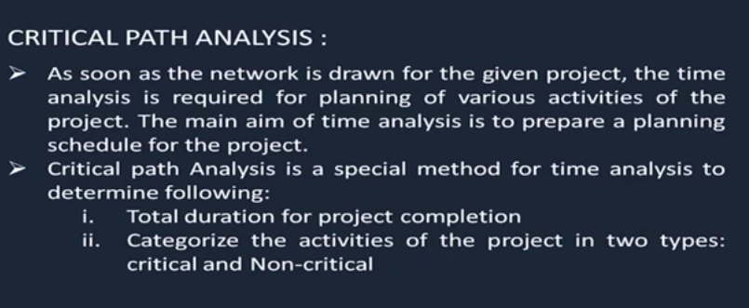

Slide 29
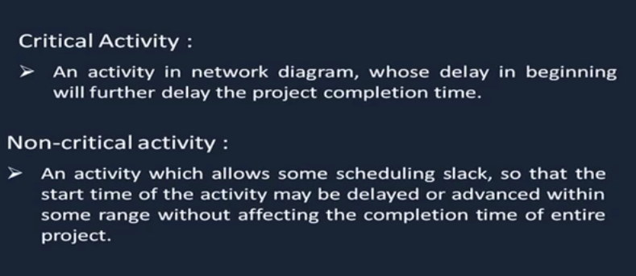

Slide 30
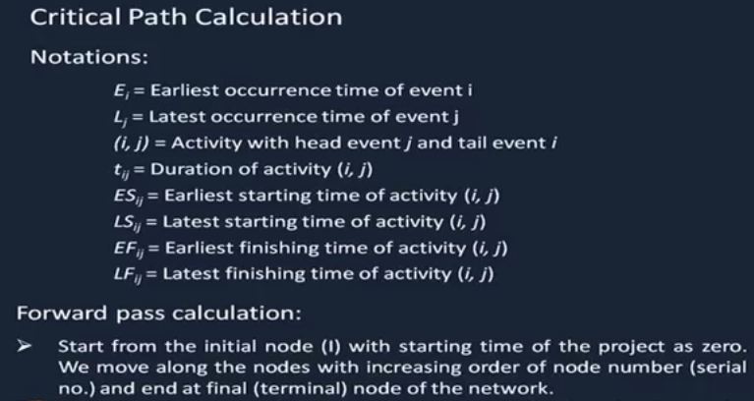

Slide 31
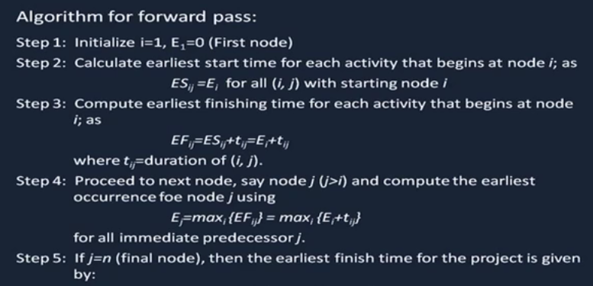

Slide 32
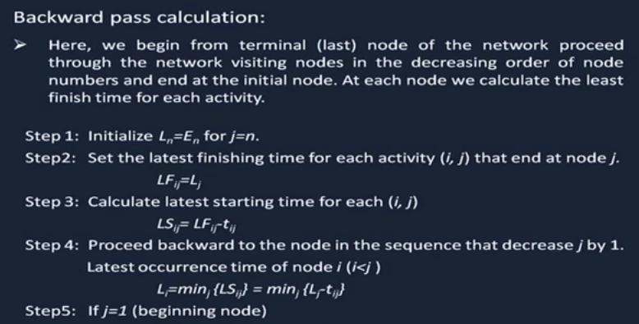

Slide 33
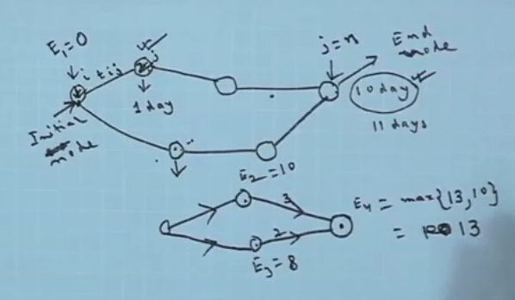

Slide 34
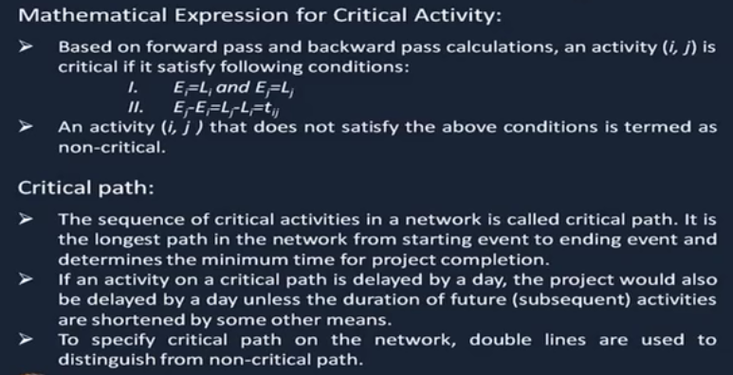

Slide 35
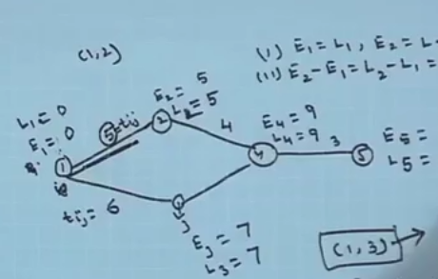


Slide 36
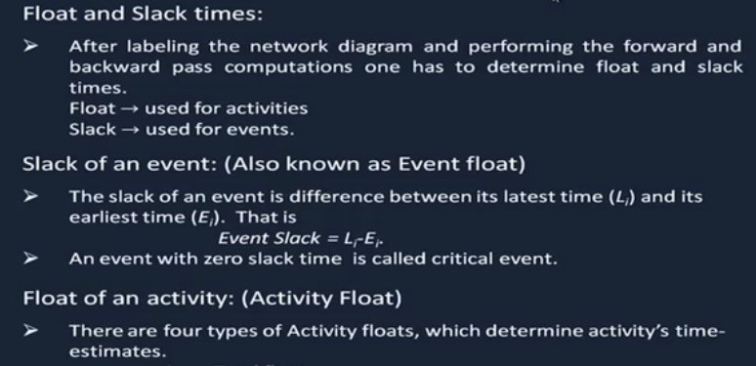

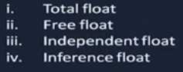

Slide 37
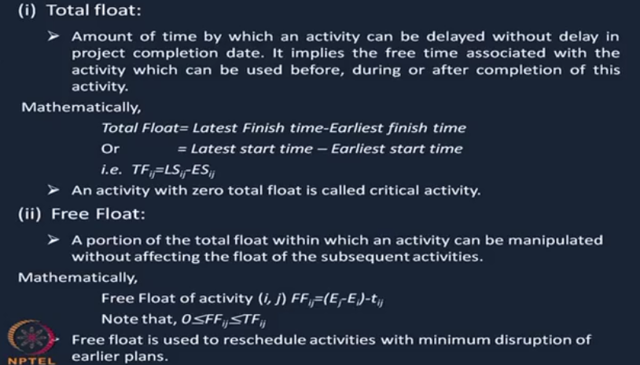

Slide 38
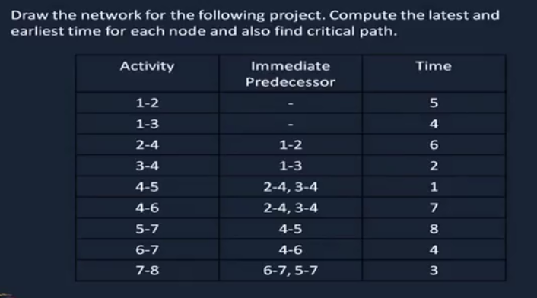

Slide 39
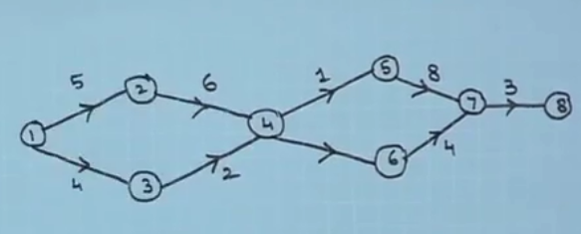

Slide 40
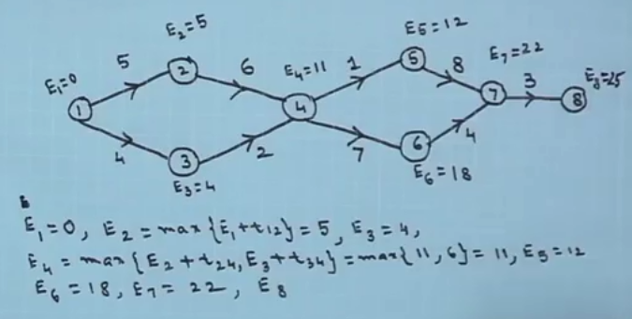

Slide 41
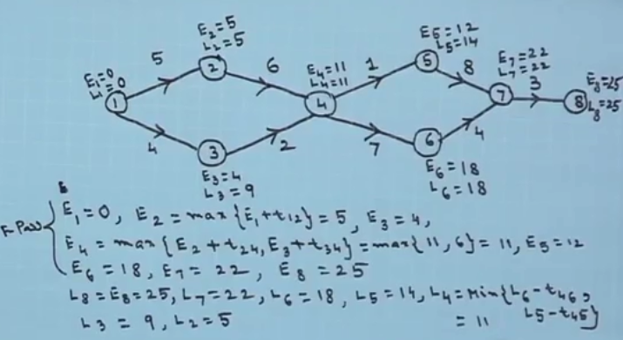

Slide 42
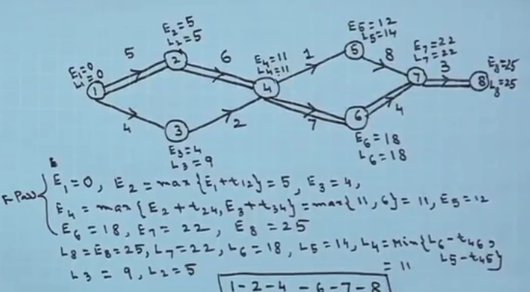

Slide 43
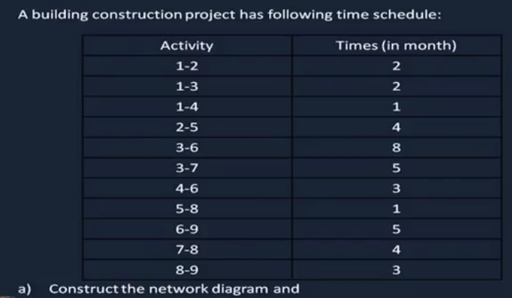

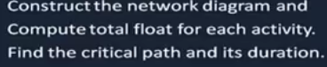

Slide 44
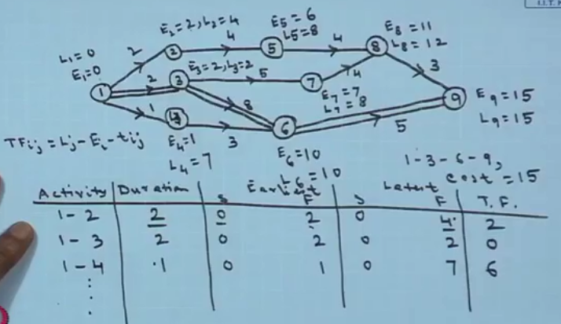

Slide 45
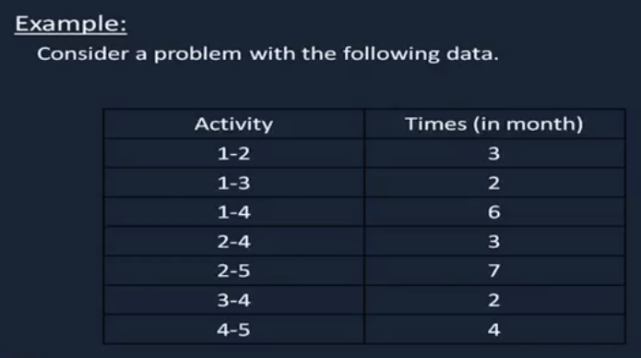

Slide 46
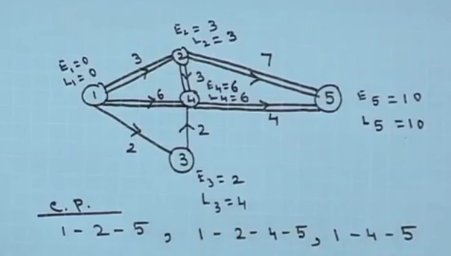

Slide 47
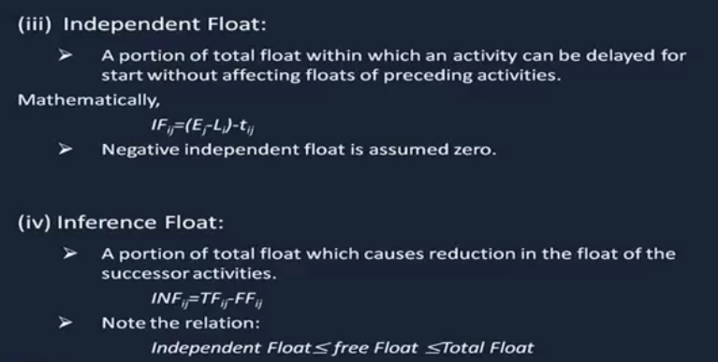

Slide 48
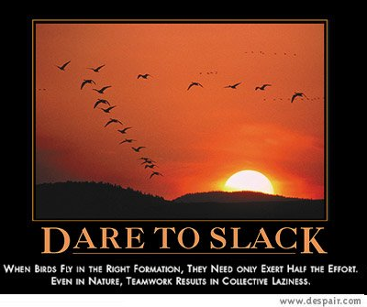
Review Questions
What is the critical path?
Do all nodes on the critical
path have to be connected
to each other? (directly)
What is slack?
When should you write your schedule for the work?
What is resource leveling?

Slide 49
Scheduling Rules of Thumb
One person should always edit the schedule (you!)
If you have two people that need to, create two files and link them together
Keep it simple and useful
Level your resources
Share the schedule with your team
40-20-40; coding is 20% of the effort

Slide 50
Schedule Example
Lets try to schedule this work among our three developers “John, Mary, Carl”
TASK | DURATION (days) | PREDECESSORs
A Graphics Engine | 14
B Sound Engine | 5 | I
C Music Engine | 5 | J
D Input Engine | 10 | A
E Gameplay/general programming | 31 | B, C, D
F Physics | 7 | E
G 2D Artwork | 14
H 3D Artwork | 21 | G
I Sound Effects | 14
J Music | 9
K Level Design | 21 | F, H

Slide 51
Scheduling Steps
Add in all the tasks (preferably in a hierarchy)
Add in all the dependencies
Break down large tasks into smaller tasks. Optimally (in Dan Fleck’s opinion) you want to schedule so the duration of each smallest task is at most 3-5 days
Assign people (resources) to tasks
Level your resources

Slide 52

Classic Mistakes
Overly optimistic schedule
Failing to monitor schedule
Failing to update schedule
Adding people to a late project
Failure to manage expectations of others
Leaving out a task
Notes:
Wed class ended with this slide

Slide 53
Tracking Progress
It is reasonable to ask whether there is a quantitative technique for assessing progress as the software team progresses through the work tasks allocated to the project schedule.
The earned value system provides a common value scale for every [software project] task, regardless of the type of work being performed. The total hours to do the whole project are estimated, and every task is given an earned value based on its estimated percentage of the total.

Slide 54
Earned Value Analysis
Stated even more simply, earned value is a measure of progress. It enables you to assess the “percent of completeness” of a project using quantitative analysis rather than rely on a gut feeling.

Slide 55
Earned Value Analysis
The budgeted cost of work scheduled (BCWS) is determined for each work task represented in the schedule. During estimation, the work (in person-hours or person-days) of each software engineering task is planned. Hence, BCWS_{i} is the effort planned for work task i. To determine progress at a given point along the project schedule, the value of BCWS is the sum of the BCWS_{i} valuesfor all work tasks that should have been completed by that point in time on the project schedule.
The BCWS values for all work tasks are summed to derive the budget at completion (BAC). Hence,BAC (BCWSk) for all tasks k.
Next, the value for budgeted cost of work performed (BCWP) is computed. The value for BCWP is the sum of the BCWS values for all work tasks that have actually been completed by a point in time on the project schedule.

Slide 56
Earned Value Analysis
Wilkens [Wil99] notes that “the distinction between the BCWS and the BCWP is that the former represents the budget of the activities that were planned to be completed and the latter represents the budget of the activities that actually were
completed.”

Slide 57
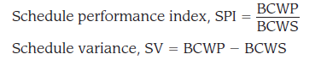
Earned Value Analysis
Given values for BCWS, BAC, and BCWP, important progress indicators can be computed:
SPI is an indication of the efficiency with which the project is utilizing scheduled resources. An SPI value close to 1.0 indicates efficient execution of the project schedule.
SV is simply an absolute indication of variance from the planned schedule.

Slide 58
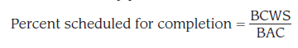
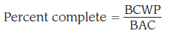
Earned Value Analysis
provides an indication of the percentage of work that should have been completed by time t.
provides a quantitative indication of the percent of completeness of the project at a given point in time t.

Slide 59
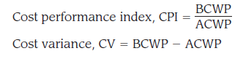
Earned Value Analysis
It is also possible to compute the actual cost of work performed (ACWP). The value for ACWP is the sum of the effort actually expended on work tasks that have been completed by a point in time on the project schedule. It is then possible to compute
A CPI value close to 1.0 provides a strong indication that the project is within its defined budget. CV is an absolute indication of cost savings (against planned costs) or shortfall at a particular stage of a project.

Slide 60
Earned Value Management
How much work you planned to have accomplished by now (in dollars or hours) called the Planned Value
How much you have actually spent by now (in dollars or hours), called Actual Cost
The value, in terms of your baseline budget, of the work accomplished by now (in dollars or hours), called the Earned Value!
Idea is to link schedule and cost together to monitor both in the same “units” of value

Slide 61
Earned Value Management
Planned value (PV) - the value of all resources needed to meet the project’s objectives
Each objective of a project has an associated planned value
Budgeted (cost) at completion (BAC) - The sum of all the PVs
Earned value (EV) - the amount of value completed at any point during the project
Actual Cost (AC) - actual amount of money you have spent so far. In a perfect project AC and EV are the same.

Slide 62
Earned Value Management Example
We’ve budgeted $200 to buy, setup, network and test a new system
Our planned values (PVs) of each task are:
Buy - $50, Setup - $75, network - $50, test - $25
Our BAC is therefore $200
We’ve now completed phase one, and thus our earned value (EV) is now $50.
To do this we spent $60 (our actual cost (AC))

Slide 63
Earned Value Management Example
Schedule performance index (SPI)
EV / PV --> 50/50 = 1 (perfect).
Our group is on schedule
Cost performance index (CPI)
EV / AC --> 50/60 = 0.83
For every dollar spent, I get 83 cents worth of work.
Estimated cost at completion (EAC)
BAC / CPI = 200 / 0.83 = $240.96
Schedule Variance (SV) : EV - PV
Cost Variance (CV) : EV - AC
Memorization Hint: Most equations begin with earned value
Notes:
SPI - we said we’d do $50 worth of work, and we did
CPI - perfect = 1
Another good example (with Gantt chart at: http://www.hyperthot.com/pm_cscs.htm)

Slide 64
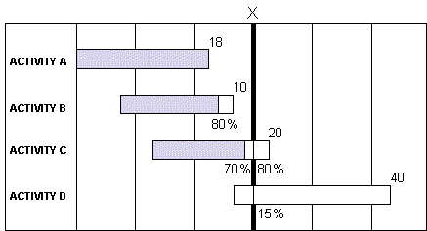
EVM Example 2 from: http://www.hyperthot.com/pm_cscs.htm
Line is at 16, blue bar ends at 14
Line is at 6
PLANNED VALUE (Budgeted cost of the work scheduled) = 18 + 10 + 16 + 6 = $50
EARNED VALUE (Budgeted cost of the work performed) = 18 + 8 + 14 + 0 = $40
ACTUAL COST (of the work performed) = $45 (Data from Acct. System)
Therefore:
Schedule Variance = 40 - 50 = -$10
Schedule Performance Index = 40 / 50 = 0.8
What is planned value at time X?
What is earned value at time X?
Earned – Planned. Perfect is?

Slide 65
What is earned value?
A. The amount of money you get upon completion of a task
B. The value of an activity
C. The value of the work completed by now in the schedule
D. The value of all activities planned to be completed by now in the schedule

Slide 66
Why do you use earned value management?
A.It is required by my contract
B. Measuring value give you more information than measuring cost or time alone
C. I don’t use it
D. It guarantees my project will be done on time

Slide 67

Scope Creep
BOO!
Scope
The scope of your project is all the work you initially planned to do.
Scope creep is when your project gets new tasks throughout it’s lifetime without adding more resources to handle new tasks. The scope is “creeping” up…
Scope changes are OK, and really unavoidable… that’s fine. However you must update the resources (time, features or people accordingly)

Slide 68
Why would scope changes occur?
A. You get more money to do more things
B. The customer asks you to do something extra because “it is critical for success”
C. A competing product has a feature that you must have to be competitive
D. All of these

Slide 69

Scope Change versus Creep
Change is good!
Your company has a $1million dollar contract with a defined scope.
Scope change:
Customer: please add all these requirements, and I’ll increase the contract to $2million dollars
Manager: Certainly! ☺
Scope creep:
Customer: please add all these requirements, and I’ll be really happy.
Manager: Certainly! ☹

Slide 70
Which are causes of scope creep?
A. poor change control
B. lack of proper initial identification of what is required to satisfy project objectives
C. a weak project manager
D. all of these Source: Wikipedia: Scope Creep

Slide 71
Managing Scope
Scope
How to deal with the inevitable “Scope creep”?
Joint Application Development and prototyping
Formal change approval
Defer additional requirements as future system enhancements
Notes:
JAD - Joint Application Development sessions - intense sessions offsite to discuss only requirements,
create prototypes, estimates, budget, etc… essentially a focused swe meeting

Slide 72
Managing Risk
Document your risks in a risk management plan
Description of risk
Likelihood of occurrence (0-100%)
Impact - 1(low) → 5 (high), or cost $20,000
Exposure = Impact * Likelihood
Mitigation strategy
How to lessen the impact of the risk
How to lessen the likelihood
An action plan if risk occurs
Update and track your risks
Communicate your risks to upper management
Notes:
Buy your fire extinguisher now, not when your house is on fire

Slide 73
Projects get into trouble when…
Software people don’t understand their customer’s needs.
The product scope is poorly defined.
Changes are managed poorly.
The chosen technology changes.
Business needs change [or are ill-defined].
Deadlines are unrealistic.
Users are resistant.
Sponsorship is lost [or was never properly obtained].
The project team lacks people with appropriate skills.
Managers [and practitioners] avoid best practices and lessons learned.

Slide 74
Common-Sense Approach to Projects
Start on the right foot. This is accomplished by working hard (very hard) to understand the problem that is to be solved and then setting realistic objectives and expectations.
Maintain momentum. The project manager must provide incentives to keep turnover of personnel to an absolute minimum, the team should emphasize quality in every task it performs, and senior management should do everything possible to stay out of the team’s way.
Track progress. For a software project, progress is tracked as work products (e.g., models, source code, sets of test cases) are produced and approved (using formal technical reviews) as part of a quality assurance activity.
Make smart decisions. In essence, the decisions of the project manager and the software team should be to “keep it simple.”
Conduct a postmortem analysis. Establish a consistent mechanism for extracting lessons learned for each project.

Slide 75
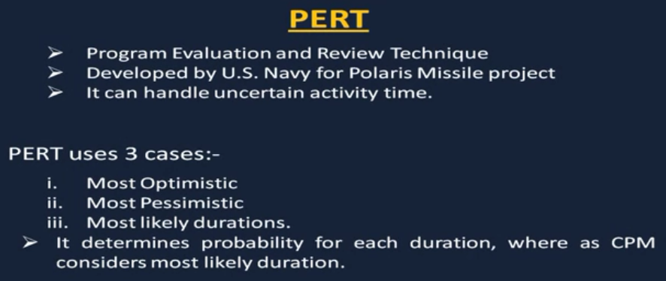

Slide 76
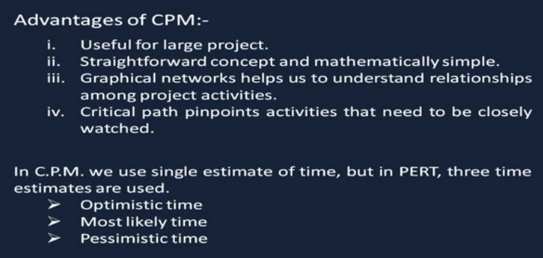

Slide 77
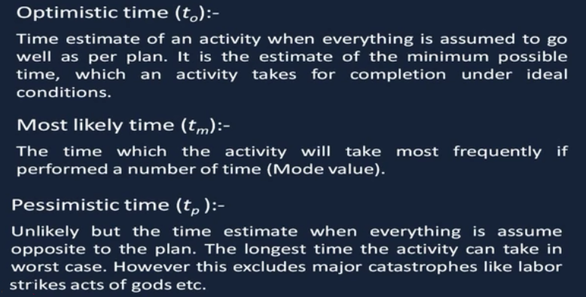

Slide 78
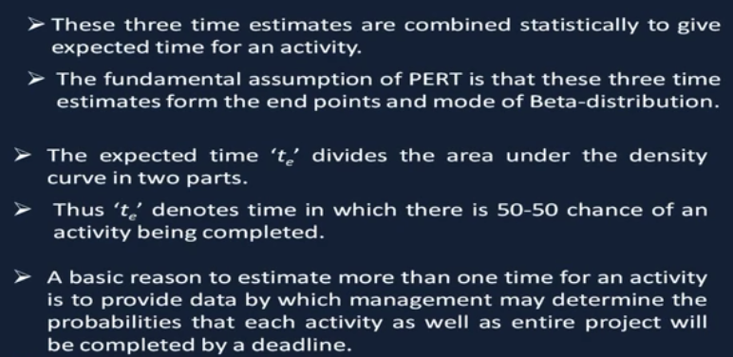

Slide 79
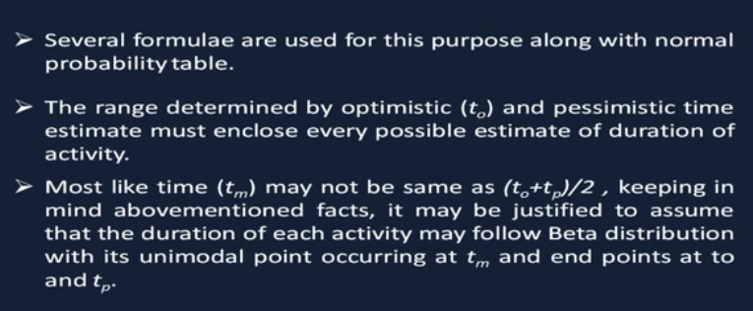

Slide 80
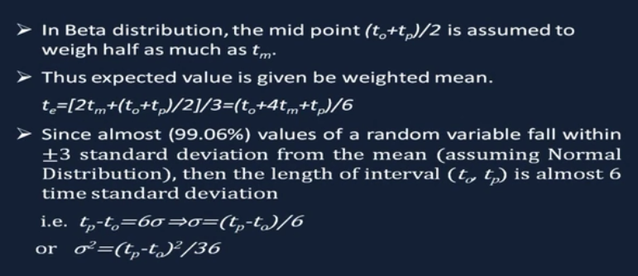

Slide 81
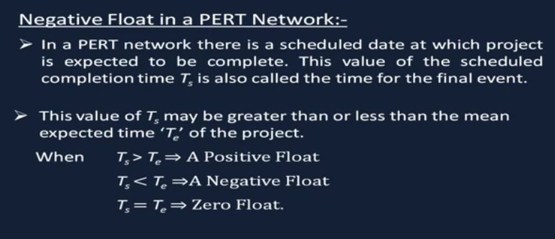

Slide 82
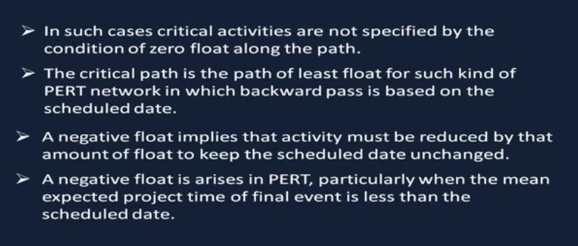

Slide 83
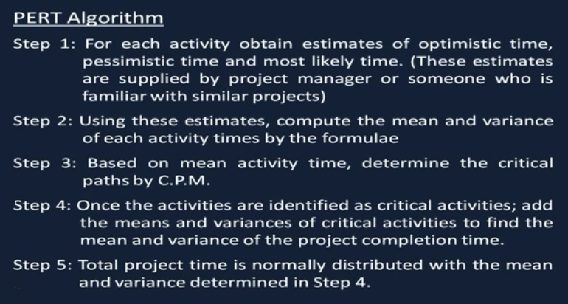

Slide 84
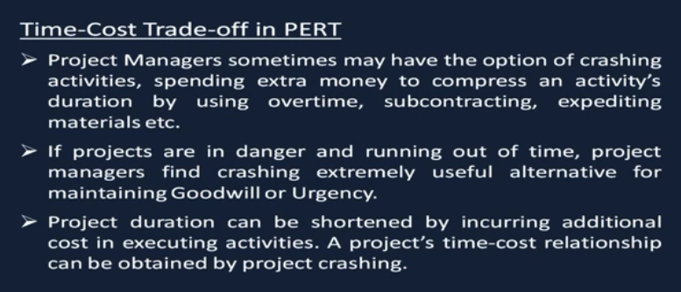

Slide 85
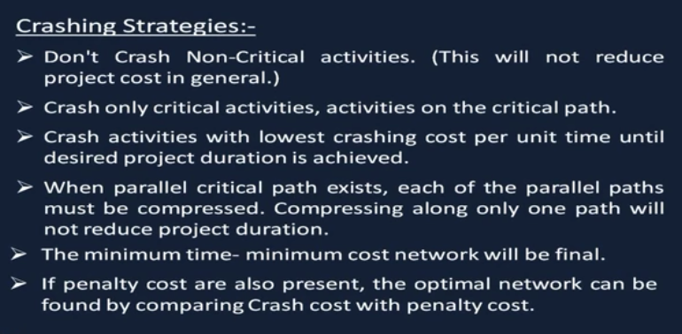

Slide 86
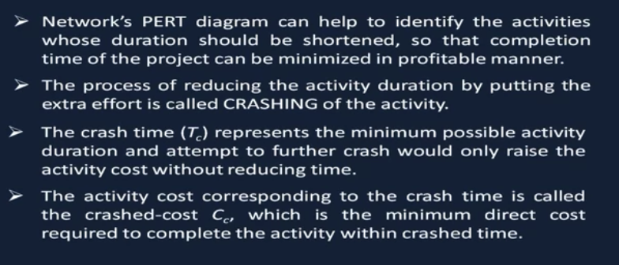

Slide 87
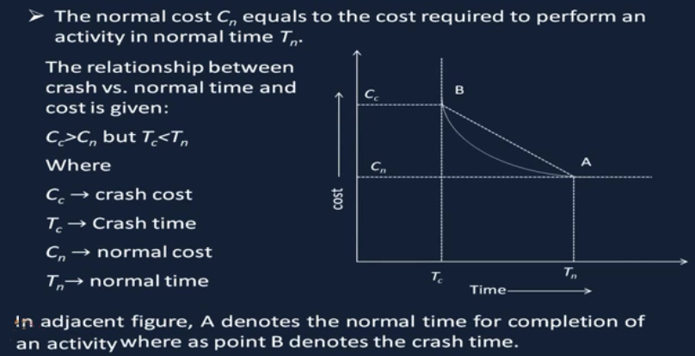

Slide 88


Slide 89


Slide 90


Slide 91


Slide 92


Slide 93






Slide 94


Slide 95


Slide 96


Slide 97


Slide 98


Slide 99


Slide 100


